Slide 1
Planning Objections – some guidance
This presentation is based on the guidance given to local councils by Harrogate District Council (HBC) planning department.
What it attempts to clarify is the type of considerations that the Planning dept at HBC take into consideration (Material Considerations) and at the end, a list of those factors that are very unlikely to be taken into consideration (non-material considerations)
Thus, when constructing your objection, try to come up with as many points that will be classified as ‘material objections’. There is no need to spell out each category, just phrase your wording so that it is clearly to do with e.g. density of the buildings.
This is no guarantee of objection success, but will help you make the planning dept tick as many boxes on their material objection checklist for your application as possible.

Slide 2
Examples of material considerations
National Policy – National Planning Policy Framework (NPPF), National Practice Guidance (NPG), Minerals Waste Plan, Neighbourhood Plans
Local Plan – emerging Plans / policies
SPG’s (Supplementary Planning Guidance Notes / SPD’s (Supplementary Planning Document’s)
Views of consultees – Highways, Health, Police, Parish / Town Councils, Environment Agency etc
Planning history of the site

Slide 3
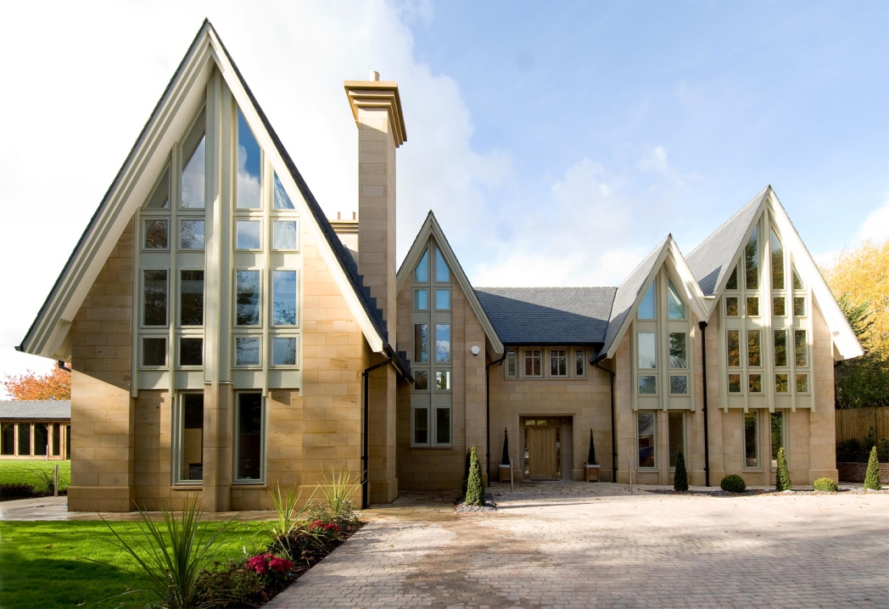
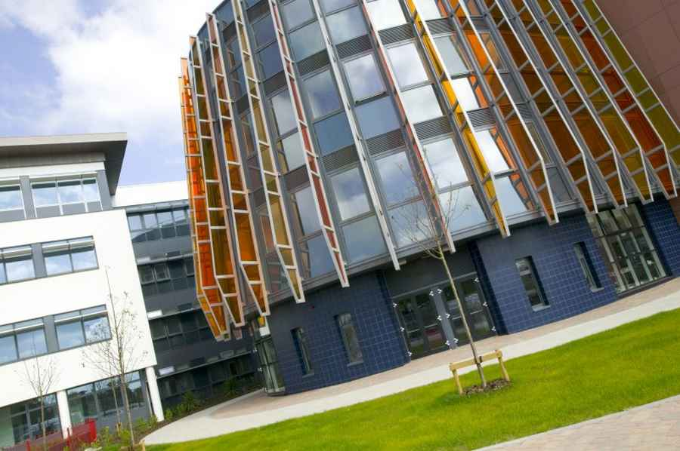
Material Considerations
Design, visual appearance, materials

Slide 4
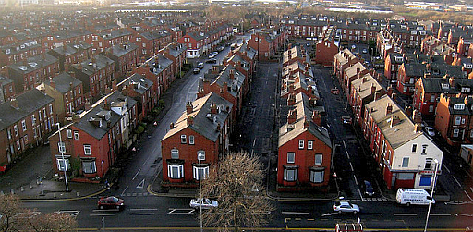
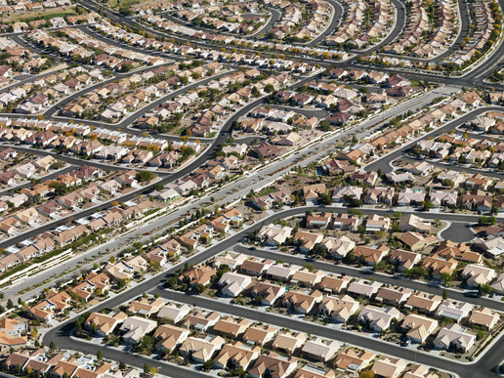
Material Considerations
Layout and density of buildings

Slide 5
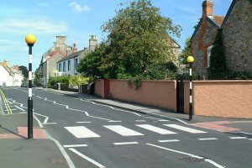
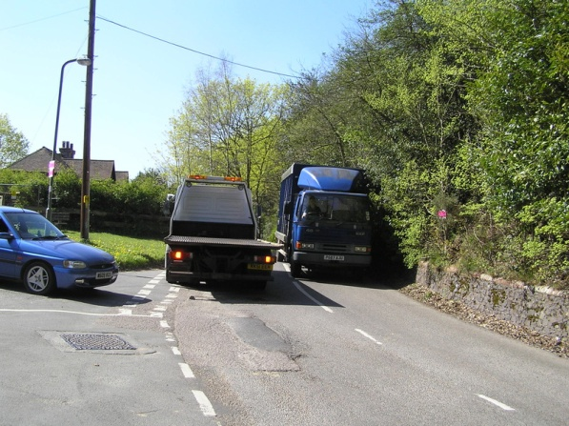
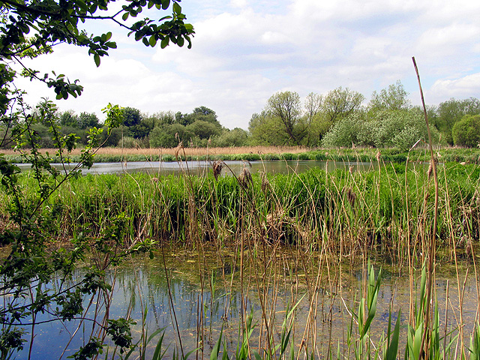
Material Considerations
Highway safety issues, parking, access, traffic generation
Loss of important trees, Landscaping, Nature conservation

Slide 6
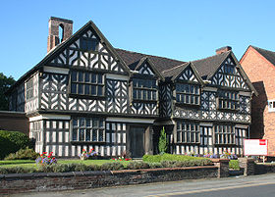
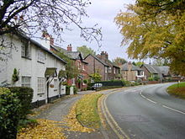
Material Considerations
Intrusion into the Open Countryside/ Green Belt
Effect on Listed Buildings and Conservation Areas
Viability
Planning History – where extant permission
....5 Year supply !

Slide 7
Material Considerations - Site Planning Factors
Impact on adjoining land / site
Visual impact (street scene etc.)
Design and materials
Privacy / overbearing
Daylight / sunlight
Access / car parking / traffic generation
Health and safety
Crime and disorder
Site levels, existing site features (trees, habitat), contamination

Slide 8
Factors unlikely to be material
The applicant and / or agent
Land ownership and occupation / Boundary Disputes
Private rights over land
Restrictive covenants
Loss of property values
Competition
Moral objections
Better use or site (except in special cases)
Differences from previous schemes
Loss of view
Where other legislation applies
Personal circumstances or hardship

